Slide 1

Customer Churn

Slide 2
Introduction
This dataset belongs to an e-commerce company, where we analyze customer behavior to identify those who have churned (stopped using the service). Understanding churn patterns helps businesses improve customer retention strategies.
Our goal is to explore key factors influencing churn, analyze trends, and develop a predictive model to anticipate future churn, enabling proactive decision-making to enhance customer experience and engagement.

Slide 3
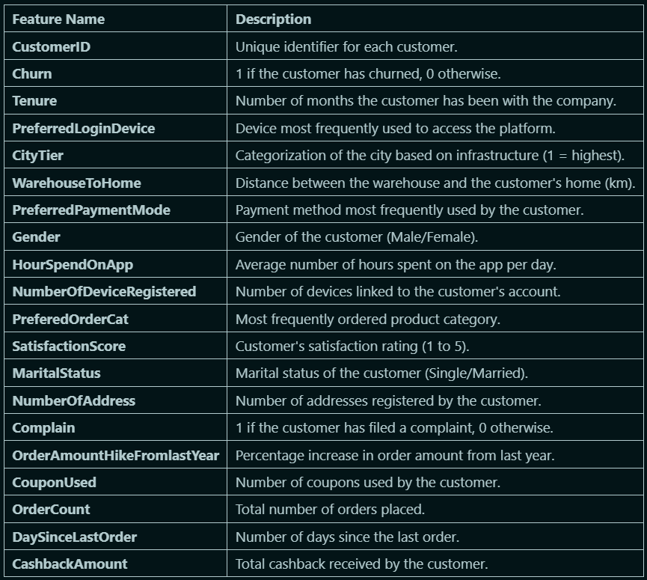
Features and Descriptions

Slide 4
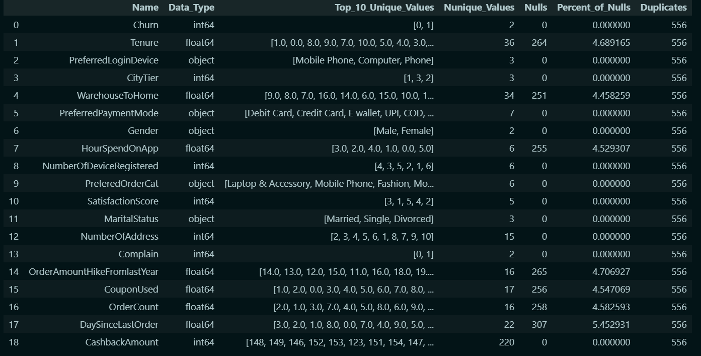
OverView
1. Shape of the Dataset is 5630 rows and 20 columns.
2. Nulls are 1,856 null values, accounting for 33% of the data.
- These missing values will be handled later.
3. Duplicates are 556 duplicate rows, which will be dropped later.

Slide 5
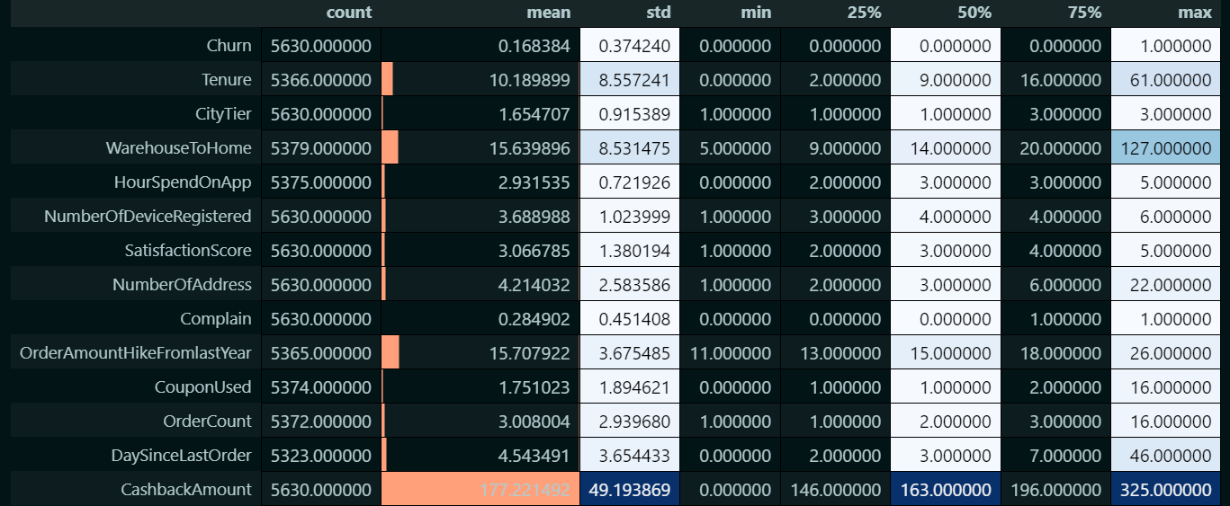
Summary Statistics
4. Outliers That Will Be Handled:
- WarehouseToHome has a maximum value of 127, which is significantly higher than the 75th percentile (20). This suggests potential outliers.
- DaySinceLastOrder has a maximum value of 46, which may indicate inactive users.
- CashbackAmount has a maximum value of 325, much higher than the 75th percentile (196).
5. Target Variable: Churn
- 16.8% of customers have churned (mean = 0.168), indicating class imbalance.
- This imbalance will be addressed using resampling techniques.

Slide 6

Exploratory Data Analysis

Slide 7
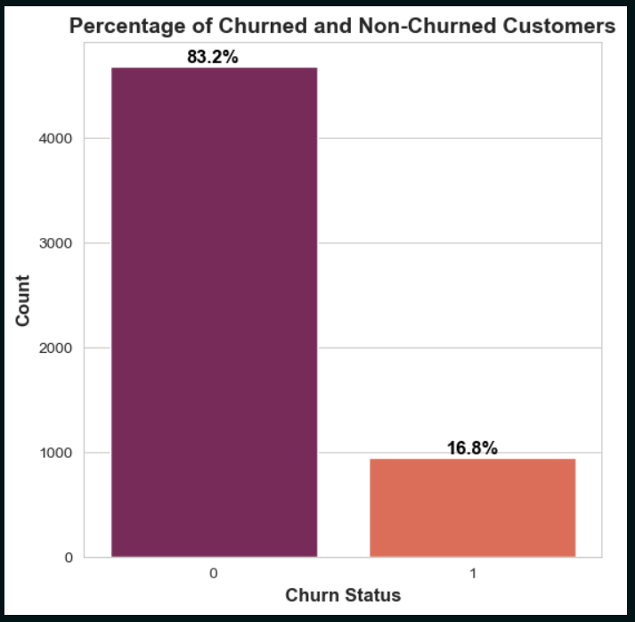
Target Column
1.Most Customers Did Not Churn:
- The majority of customers (83.2%) remained with the company (churn status = 0).
- Only 16.8% of customers churned (left the company, churn status = 1).
2. Since 83.2% of customers stayed, the company has a relatively high customer retention rate.

Slide 8
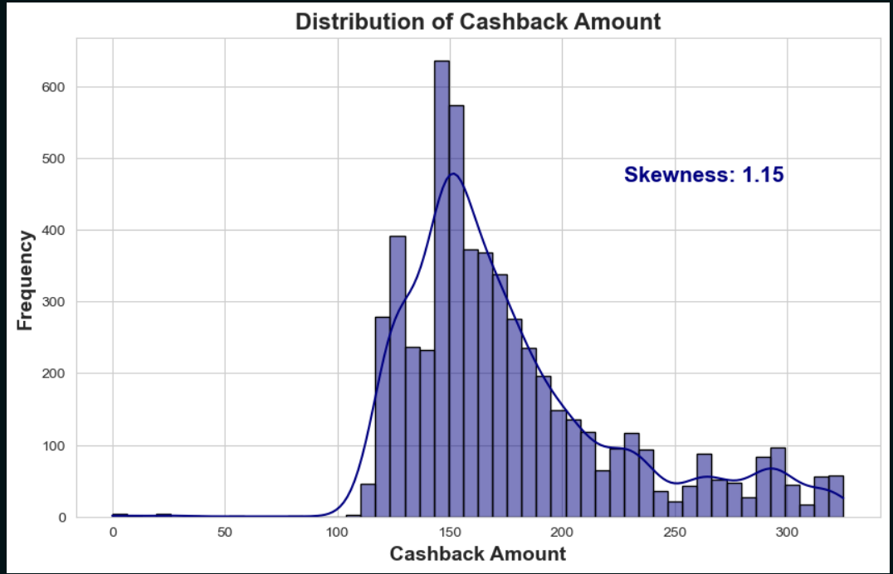
Cashback Amount
The distribution has a longer tail on the right side, indicating that while most cashback amounts are concentrated at lower values (around 150), some higher cashback amounts exist but are less frequent.
This suggests that a few customers receive significantly higher cashback amounts compared to the majority.
The highest frequency is around 140–160, meaning that most cashback transactions fall within this range.
Cashback amounts are mostly between 140–160, but higher values create right skewness.
There are two types of outliers:
Left-side (zero cashback) due to system restrictions or eligibility issues.
Right-side (high cashback) due to big spenders or potential anomalies.

Slide 9
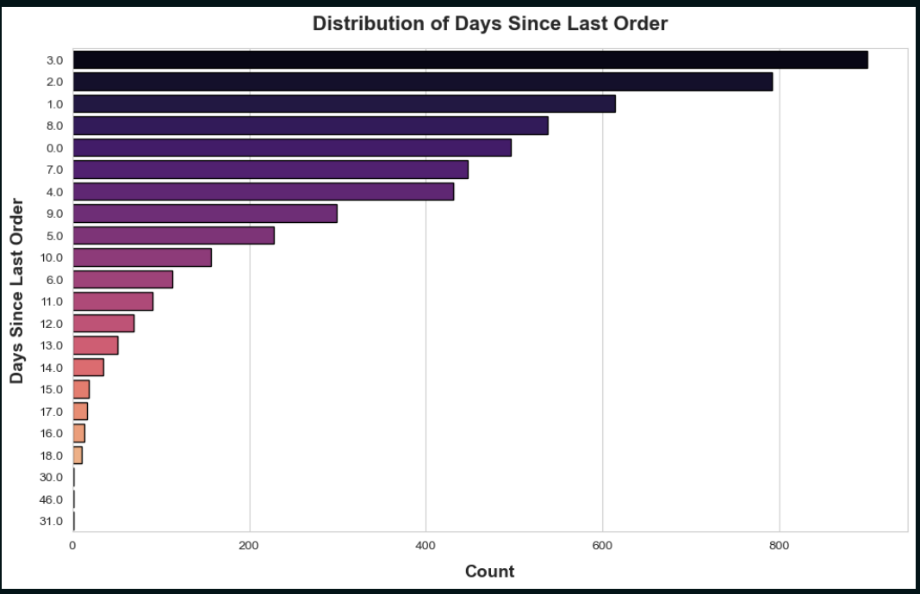
Days Since Last Order
1. Recency of Customer Orders
- The majority of customers have placed their last order within the past 3 days.
- The most common values are 8, 1, 2, and 3 days.
- As the number of days since the last order increases, the frequency decreases.
2. Potential Customer Segments
- Frequent Buyers: Customers who order within 0-3 days may be highly engaged and loyal.
- Occasional Buyers: Customers with a gap of 5-10 days could be targeted with re-engagement strategies.
- Churned Customers: Customers with gaps of 30+ days may need win-back campaigns.
3. Business Strategy Implications
- Consider loyalty programs or personalized discounts for customers who haven’t ordered in 10+ days.
- Retention campaigns should focus on the 5-10 day segment to prevent churn.

Slide 10
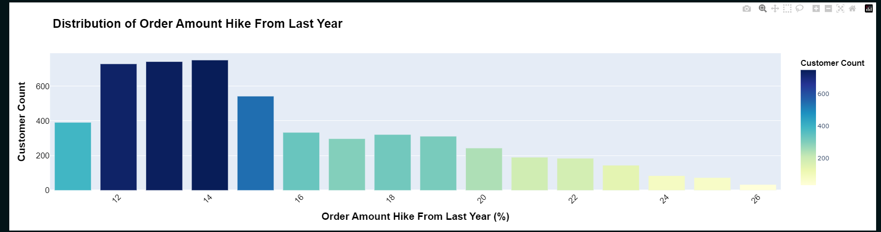
Order Amount Hike From Last Year
Most Common Order Hike Values
The most frequent order amount hikes are around 12% to 14%, suggesting that most customers experienced a moderate increase in order amounts.
Decrease in Customer Count with Higher Hikes
As the order hike percentage increases beyond 16%, the number of customers drops, indicating lower acceptance of high price increases.
Distribution Pattern
The distribution is right-skewed, meaning most customers face smaller hikes, while only a few experience significantly larger ones.
Business Implications
Price Sensitivity: Customers tend to be sensitive to price changes, with higher hikes causing drop-offs.
Optimal Pricing Strategy: Keeping hikes within the 12%–14% range helps retain the most customers.
Revenue Risk: Hikes beyond 16%–18% could lead to notable customer churn and potential revenue loss.

Slide 11
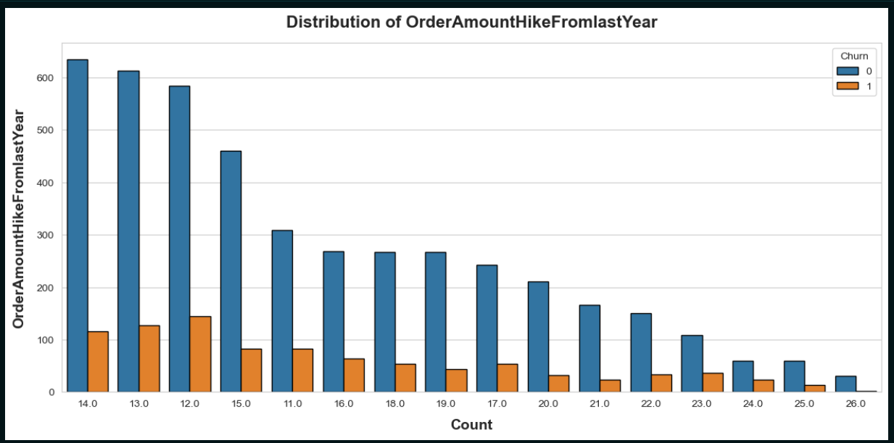
OrderAmountHikeFromlastYear & Churn

Slide 12
Insights
Order Hike Range (12–15%)
High customer frequency in this range indicates that most customers experience a moderate order hike.
Low churn rate suggests that the majority are comfortable with this level of increase.
A small percentage still churn, likely due to price sensitivity.
Higher Order Hikes (20%+)
Fewer customers fall into this category, but most of them remain loyal (high retention).
Indicates the presence of high-value customers who stay due to better perceived value or cashback incentives.
These customers are likely less sensitive to price hikes when additional benefits are provided.
Key Takeaways & Strategy
Moderate price hikes (12–15%) retain the bulk of customers with minimal churn.
For higher hikes (20%+), cashback or incentive programs help retain fewer but valuable loyal customers.
Businesses should optimize pricing and cashback strategies to balance profitability with customer retention, especially among price-sensitive segments.

Slide 13
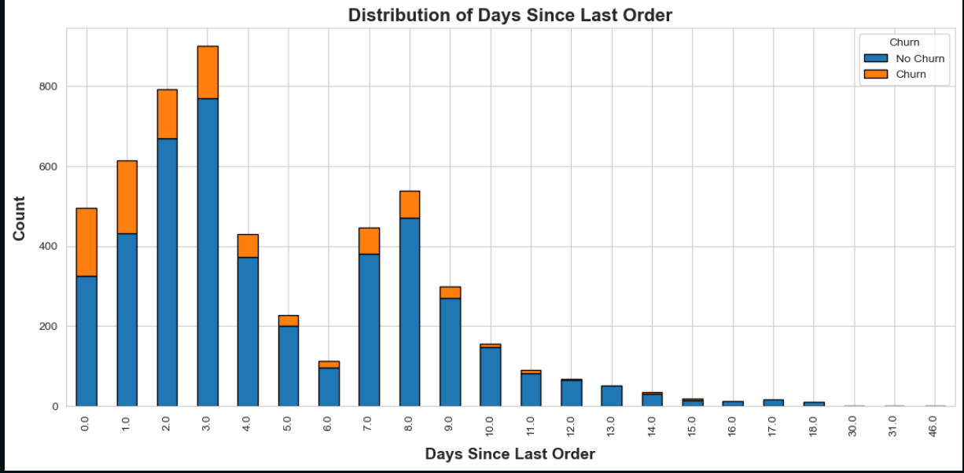
DaySinceLastOrder & Churn

Slide 14
Insights
1: Frequent Purchasers
Observation: A large portion of customers make repeat purchases within the first 3 to 4 days.
Implication: Indicates a core group of highly engaged and loyal customers who are satisfied with the service/product.
2: First-Time Users Who Churn
Observation: A smaller percentage of users churn within the same 3 to 4-day period.
Implication: Likely first-time users who don’t return, suggesting the need to enhance onboarding and provide conversion incentives.
3: Long-Term Inactive Customers
Observation: A noticeable percentage have been inactive for 20–26 days.
Implication: These customers are at high risk of churn and require re-engagement efforts.
Strategic Recommendations
Enhance Onboarding Experience
Guide new users effectively to increase retention and repeat purchases.
Retention Campaigns
Target inactive users with personalized offers and re-engagement strategies.
Loyalty Programs
Reward frequent purchasers to maintain loyalty and increase customer lifetime value.

Slide 15
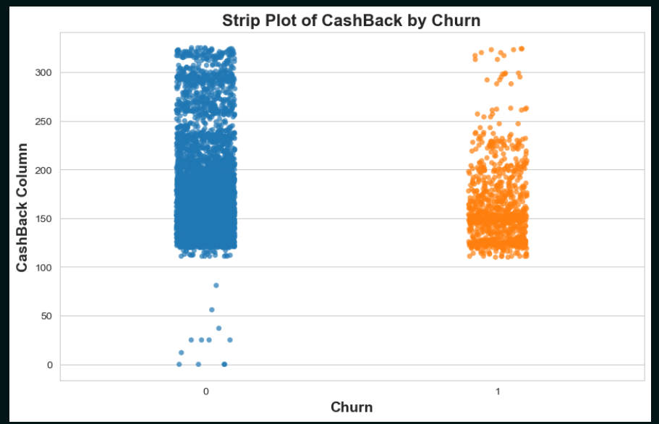
CashBack & Churn

Slide 16
Insights
Distribution of Cashback Values
Non-churners (blue dots) show a wider range and higher density of cashback values.
Churners (orange dots) are concentrated in a narrow, lower-value range.
Cashback values above 250 are significantly more common among non-churners.
2: Cashback Impact on Churn
Higher cashback is correlated with lower churn rates.
Churners typically receive cashback within a lower, narrower range.
While some non-churners also get low cashback (0–50), they are less frequent.
Conclusion: Cashback is a strong retention factor, but not the sole influencer.
3: Business Takeaways
Increase cashback incentives strategically to retain customers.
Low cashback recipients are more likely to churn—indicating room to optimize the cashback policy.
Consider a tiered or personalized cashback system to balance retention and profitability.

Slide 17
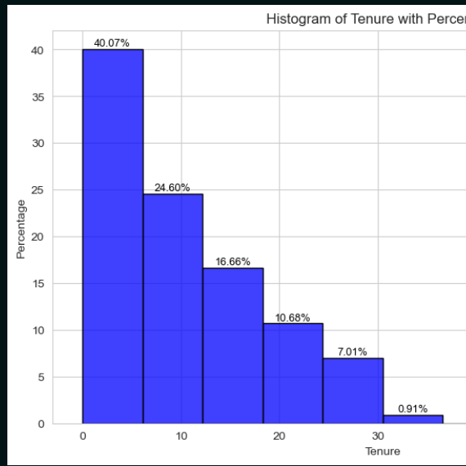
Tenure
- we can observe that the majority of customers remain within a tenure range of 0 to 6.5 months.
This indicates that customer retention - is relatively low beyond this period.

Slide 18
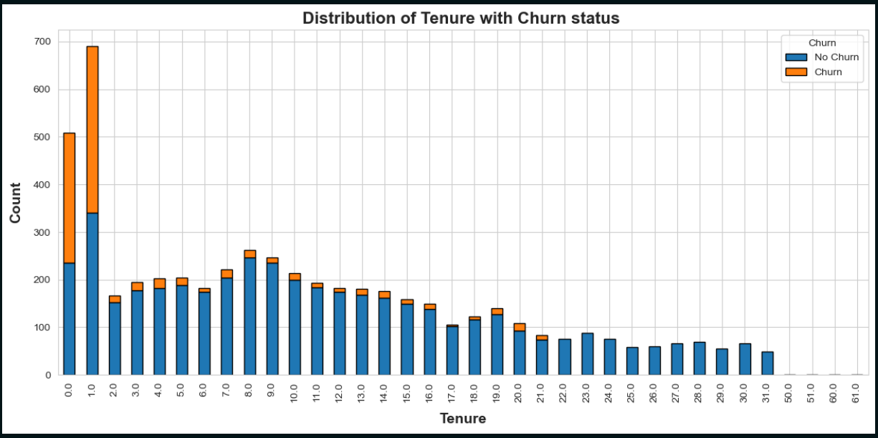
Tenure & Churn

Slide 19
Insights
1: Tenure vs Churn Status – Key Observations
0.0 to 1.0 Tenure: Higher churn rate (orange) compared to non-churned customers (blue).
Beyond 1.0 Tenure: Non-churned customers consistently outnumber churned ones, indicating loyalty.
2: Insights from Tenure Analysis
Short Tenure (0-1 months): High churn rate suggests dissatisfaction or lack of value early on.
Long Tenure: Loyalty and satisfaction increase, leading to reduced churn.
3: Recommendations for Early Retention
Enhance Onboarding Process: Focus on improving the initial user experience.
Offer Promotional Incentives: Provide incentives or personalized support to retain customers in the early stages.
4: Recommendations for Long-Term Engagement
Gather Feedback: Survey early churners (0-1 months) to understand dissatisfaction reasons.
Analyze Successful Features: Identify features that long-tenure customers value and replicate for new users.
Implement Loyalty Programs: Offer customized offers for long-term users to sustain engagement and reduce churn.

Slide 20
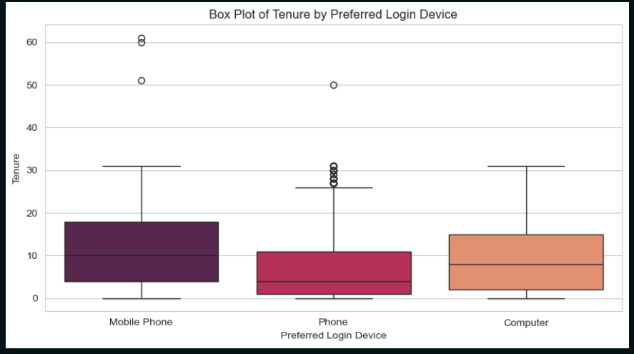
Preferred Login Device

Slide 21
Insights
1-Box Plot Analysis - Tenure by Preferred Login Device
Overview This box plot visualizes the distribution of tenure (time spent with the app) across three different preferred login devices:
Mobile Phone
Phone
Computer
2: Key Observations - Mobile Phone Users
Higher Median Tenure: Mobile phone users spend more time on the app.
Fewer Outliers: Usage is generally consistent, with few extreme values.
3: Key Observations - Phone Users
Lower Median Tenure: Users tend to spend less time on the app compared to others.
Many Outliers: There’s a small group of heavy users, but the majority have shorter usage durations.
4: Key Observations - Computer Users
Moderate Median Tenure: Usage is more balanced with a moderate level of engagement.
Wide Interquartile Range: Reflects varied usage among computer users.
Fewer Outliers: Indicates consistent engagement with the app.
5: Conclusion
Mobile Phone Users: Tend to have longer and more consistent usage times.
Phone Users: Have shorter average usage, with some extreme outliers of heavy users.
Computer Users: Show moderate, stable usage patterns.

Slide 22
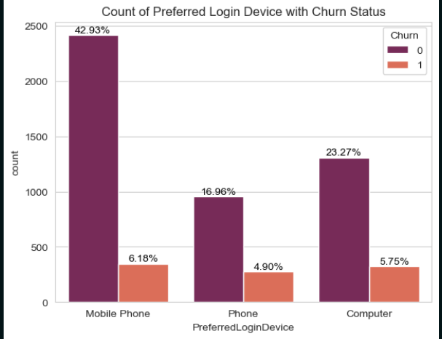
Preferred Login Device & Churn

Slide 23
Insights
1: User Login Preferences & Churn Rates
Mobile Phones:
Most popular device (42.93%)
Churn rate: 6.18%
Computers:
Second most used (23.27%)
Churn rate: 5.75%
Other Phones:
Used by 16.96%
Churn rate: 4.90%
2: Key Observations
Overall retention is strong across all device types.
Mobile phones have the highest churn count in absolute numbers, but that aligns with their large user base.
Computer users show a slightly higher churn rate compared to other device types — may indicate lower engagement or UX issues.
3: Strategic Implications
Investigate the user experience across different devices, especially computers, to uncover any friction points.
Enhance mobile and desktop UX to maintain or improve retention.
Consider device-based segmentation in marketing and retention strategies to personalize user engagement more effectively.

Slide 24
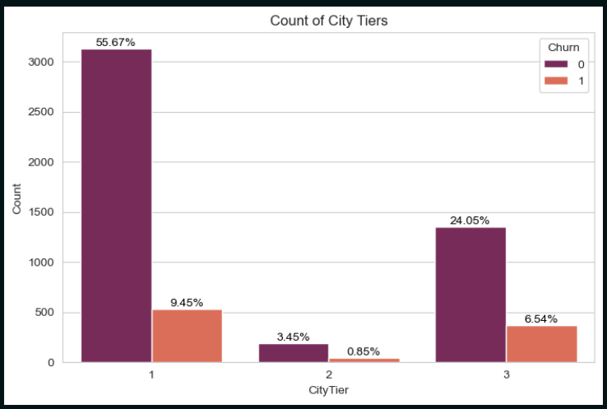
City Tiers & Churn

Slide 25
Insights
City Tier 1 – Dominance and Churn
55.67% of users are from City Tier 1.
9.45% of Tier 1 users have churned, reflecting higher churn volume due to the larger population.
Majority of users in this tier have not churned, indicating strong retention.
2: Lower Participation in City Tier 2
3.45% of users are non-churned in Tier 2.
0.85% have churned, showing low user engagement.
Reflects lower market penetration in Tier 2.
3: Notable Churn in City Tier 3
6.54% churn rate in City Tier 3, higher than Tier 2.
Likely caused by lower user satisfaction or engagement.
4: Business Strategy & Tips
Prioritize retention efforts in City Tier 1, given its large user base.
Focus on improving engagement and satisfaction in City Tier 3 to reduce churn.

Slide 26
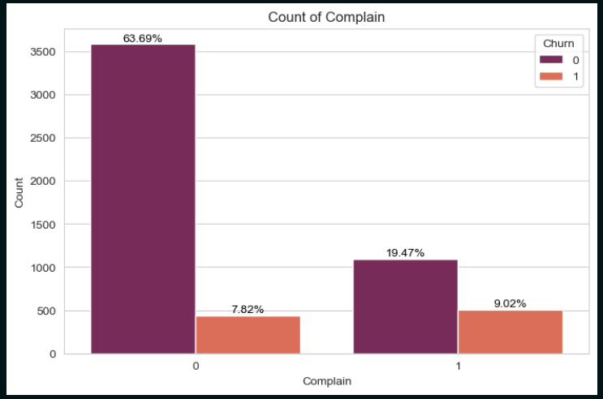
Complain & Churn
- The chart illustrates the relationship between customer complaints and churn rate.
- 63.69% of customers who did not make a complaint did not churn, indicating strong customer retention.
- Among those who did make a complaint, 19.47% did not churn, suggesting that the company's response to complaints may have been effective in satisfying customers.
- 9.02% of customers who complained still churned, which is relatively low compared to those who stayed.

Slide 27
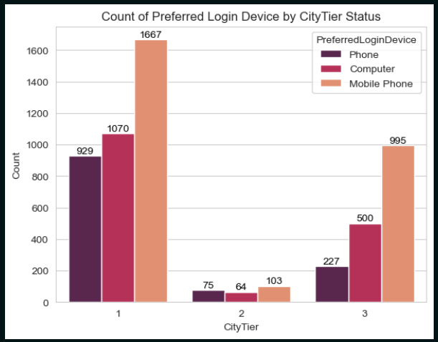
Preferred Login Device & CityTier
1: Key Observations - Device Usage by City Tier
City Tier 1:
The highest number of users across all device types.
Mobile phones are the most preferred device.
City Tier 3:
Notable usage, primarily through mobile phones and computers.
City Tier 2:
The lowest user engagement across all device types.
2: Conclusion
Mobile phones are the most commonly used devices, especially in City Tier 1, reflecting higher accessibility and smartphone penetration.

Slide 28
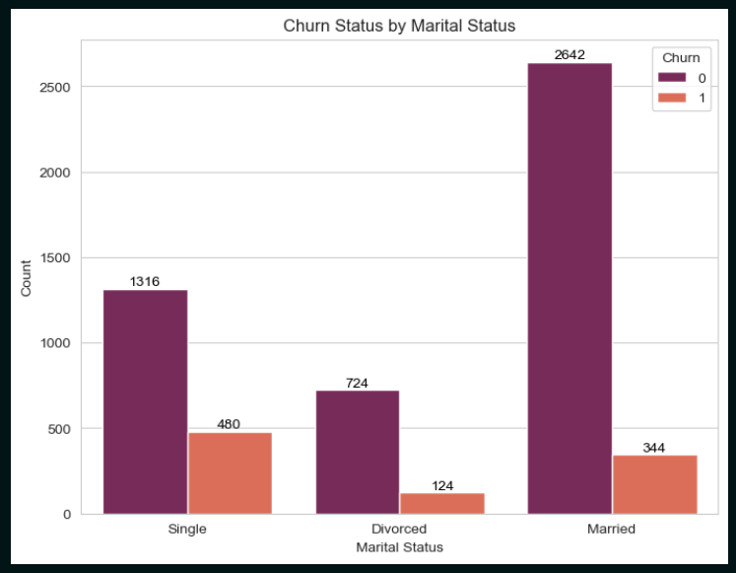
Marital Status & Churn

Slide 29
Insights
1. Married Customers Form the Largest Customer Base:
Highest number of non-churned customers (2,642) indicating a strong and loyal group.
High churned customers (344), which is expected due to their large population size.
2. Churn Proportion is Highest Among Singles:
Singles (1,796 customers) have a higher churn rate, with 480 churned, indicating they may be more prone to leaving.
3. Divorced Customers are the Smallest Group:
Divorced customers (848 customers) have a moderate churn rate, with 124 churned.
2: Potential Business Strategies
Retention Strategies for Singles:
Implement personalized services or exclusive offers to reduce churn.
Loyalty Programs for Married Customers:
Maintain or improve retention with loyalty programs or incentives.

Slide 30
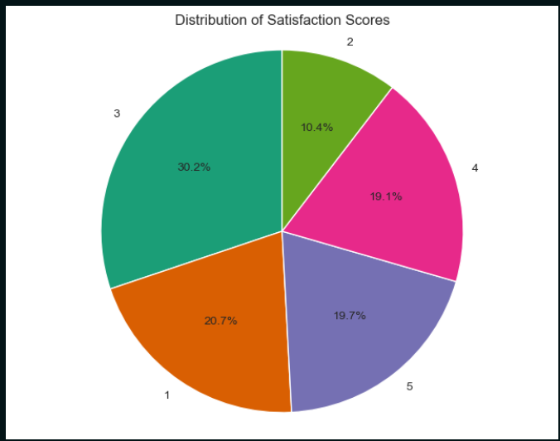
Satisfaction Score

Slide 31
Insights
High Overall Satisfaction:
70% of customers rated their satisfaction as 3 or above, indicating a generally positive experience.
Moderate Satisfaction Dominance:
The largest segment (30.2%) gave a score of 3, suggesting room for improvement and potential to elevate satisfaction with targeted strategies.
Balanced High Scores:
39% of customers gave scores of 4 or 5, reflecting a significant portion of highly satisfied customers.
Low Satisfaction (Score 2):
10.4% of customers rated 2, indicating possible dissatisfaction or unmet expectations.
2: Business Recommendations
Focus on Moderate Scores (3):
Engage with customers who gave score 3 to understand their needs and convert them into more satisfied, loyal customers.
Enhance Positive Experiences:
Analyze the drivers behind scores of 4 and 5 to leverage these strengths in marketing and customer service.
Address Dissatisfaction Early:
Investigate the concerns of customers who gave scores of 2 or 1 and offer personalized support or service recovery to reduce churn.

Slide 32
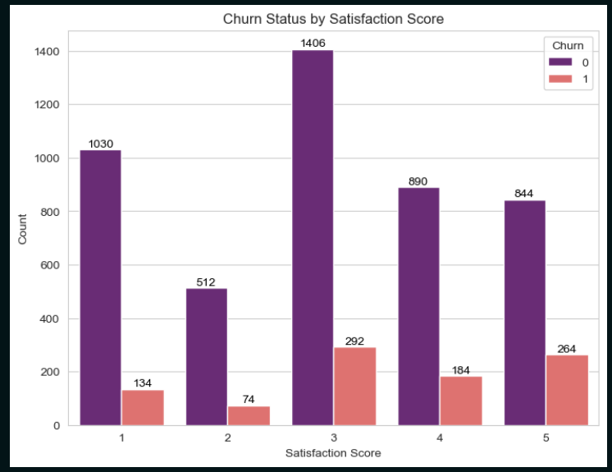
Satisfaction Score & Churn

Slide 33
Insights
High Overall Satisfaction:
70% of customers rated their satisfaction as 3 or above, indicating a generally positive customer experience.
Moderate Satisfaction Dominance:
The largest segment (30.2%) gave a score of 3, suggesting room for improvement and potential to elevate satisfaction.
Balanced High Scores:
39% of customers rated 4 or 5, reflecting a significant portion of highly satisfied customers.
Low Satisfaction (Score 2):
10.4% of customers gave a score of 2, indicating possible dissatisfaction.
2: Churn Among Highly Satisfied Customers
🔍 Noticeable Churn in High Satisfaction Scores:
Score 5 → ~23.8% churn
Score 4 → ~17.1% churn
🔎 Why Do Highly Satisfied Customers Still Churn?
One-time usage: They had a great experience but only needed the service once.
Lack of ongoing need: Satisfied but no longer interested in future purchases.
Better alternatives: Found more attractive offers elsewhere.
Not engaged: High satisfaction doesn't always correlate with high engagement or loyalty.
3: Business Recommendations
📌 Takeaway:
Customer satisfaction is important, but not enough to prevent churn.
Retention strategies should focus on engagement, repeat behavior, and delivering value over time to ensure continued loyalty.

Slide 34
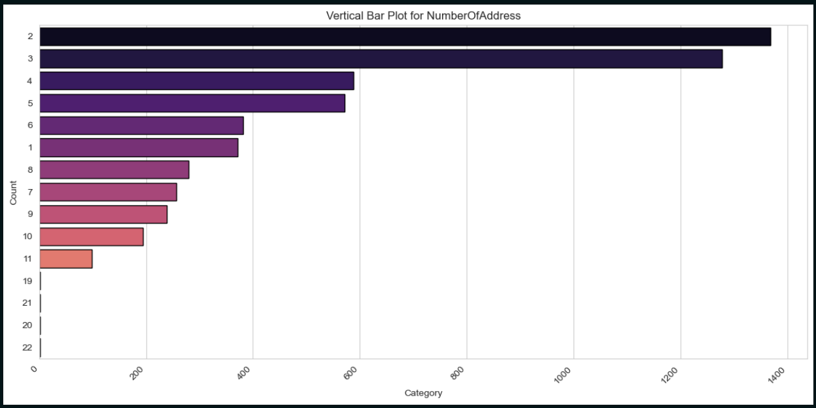
Number Of Address

Slide 35
Insights
1. Dominance of Higher Address Counts:
Categories 2 and 3 show the highest frequency, indicating that most customers maintain 2 or more addresses.
This suggests the presence of multi-location individuals or multi-user households.
2. Moderate Usage of Single Address:
Category 1 has a lower frequency, implying that fewer customers have a single address.
This suggests higher engagement from customers who manage multiple addresses
2: Long Tail Distribution and Engagement Insights
3. Long Tail Distribution:
A sharp decline in the frequency of customers maintaining 6 or more addresses.
Likely represents business accounts or high-frequency users who may have special needs or larger operations.
4. Possible Correlation with Engagement:
The presence of multiple addresses may indicate higher order frequency or greater customer loyalty.
Further analysis may confirm this as a significant engagement indicator.
3: Business Implications
5. Business Opportunity:
Target users with multiple addresses through personalized delivery offers or location-based promotions.
This could help increase retention and foster engagement among high-value customers.

Slide 36
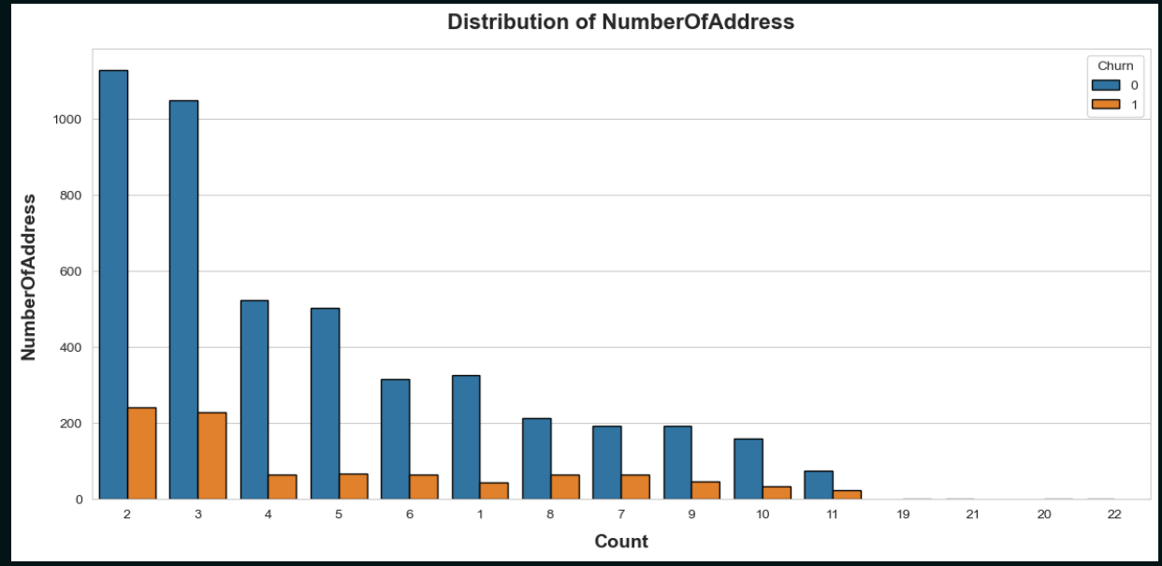
Number Of Address & Churn

Slide 37
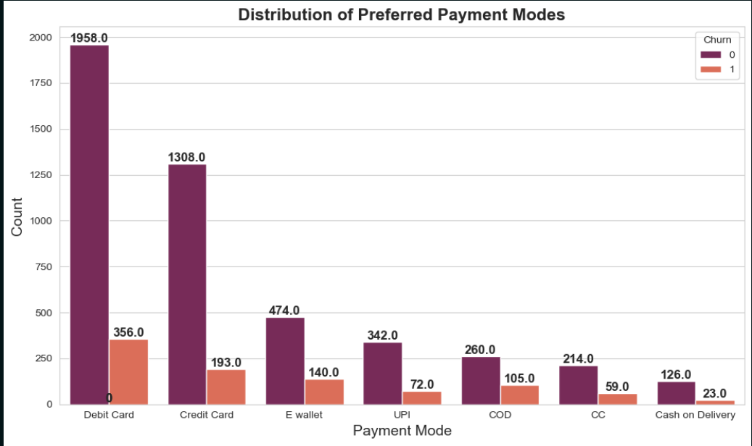
Preferred Payment Modes & Churn

Slide 38
Insights
1: E-Wallet Users - High Churn Rate
E-Wallet Users Show the Highest Churn Rate
E-wallets may not be the most popular, but they exhibit the highest churn rate.
Dissatisfaction could stem from factors like:
Trust issues
Usability concerns
Unsatisfactory rewards or incentives
2: Traditional Payment Methods - Customer Loyalty
Traditional Payment Methods Indicate Customer Loyalty
Debit Cards, Credit Cards, and UPI demonstrate significantly lower churn rates.
These customers tend to be more loyal or have habitual payment preferences, suggesting a stable user base
3: Vulnerable Segments - Low Usage & Moderate Churn
Low Usage + Moderate Churn = Vulnerable Segments
Cash on Delivery (COD) and Credit Card (CC) users show lower usage, but their churn rates are still notable.
These segments are vulnerable and may need:
Alternative engagement strategies
Enhanced incentives or support

Slide 39
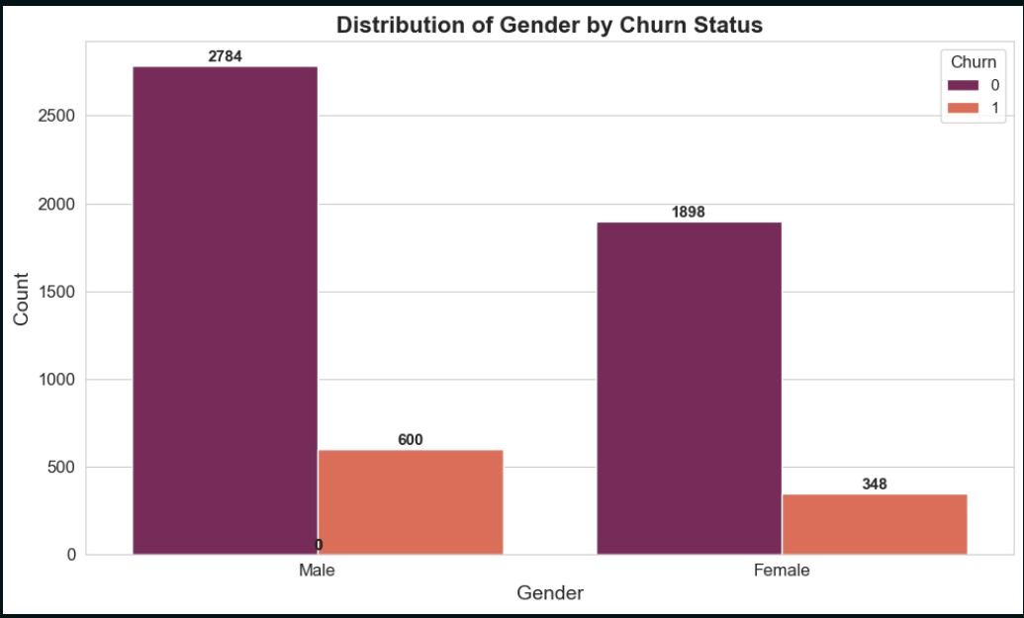
Gender & Churn

Slide 40
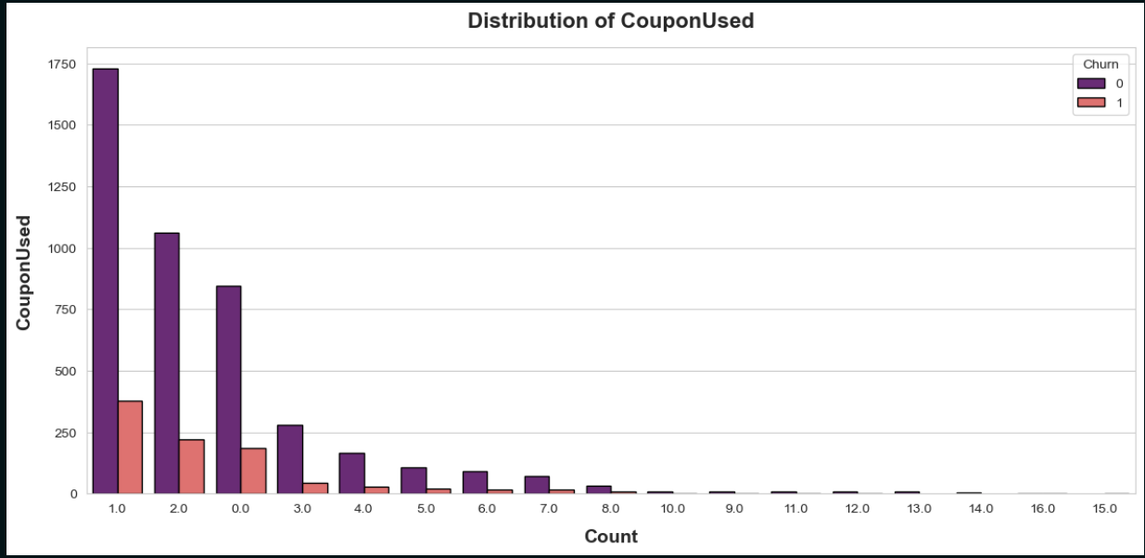
Coupon Used & Churn

Slide 41
Insights
Summary:
Most users used 0 to 2 coupons.
Churners are predominantly low coupon users.
1. Low Coupon Use is Common
The majority of customers used 1 or 2 coupons, indicating moderate adoption of promotional offers.
2. Churn Linked to Low Coupon Use
Users who have 0–1 coupons are more likely to churn.
This could be due to low engagement or missed promotional opportunities.
3. High Coupon Users are Loyal
Churn drastically drops beyond 3 coupons used, suggesting that users who redeem more coupons show higher loyalty and engagement.
Coupon redemption may be a strong indicator of increased customer stickiness.
Recommendation:
Incentivize low coupon users to increase engagement.
Trigger targeted campaigns for users with 0–2 coupons to boost usage and reduce churn.

Slide 42
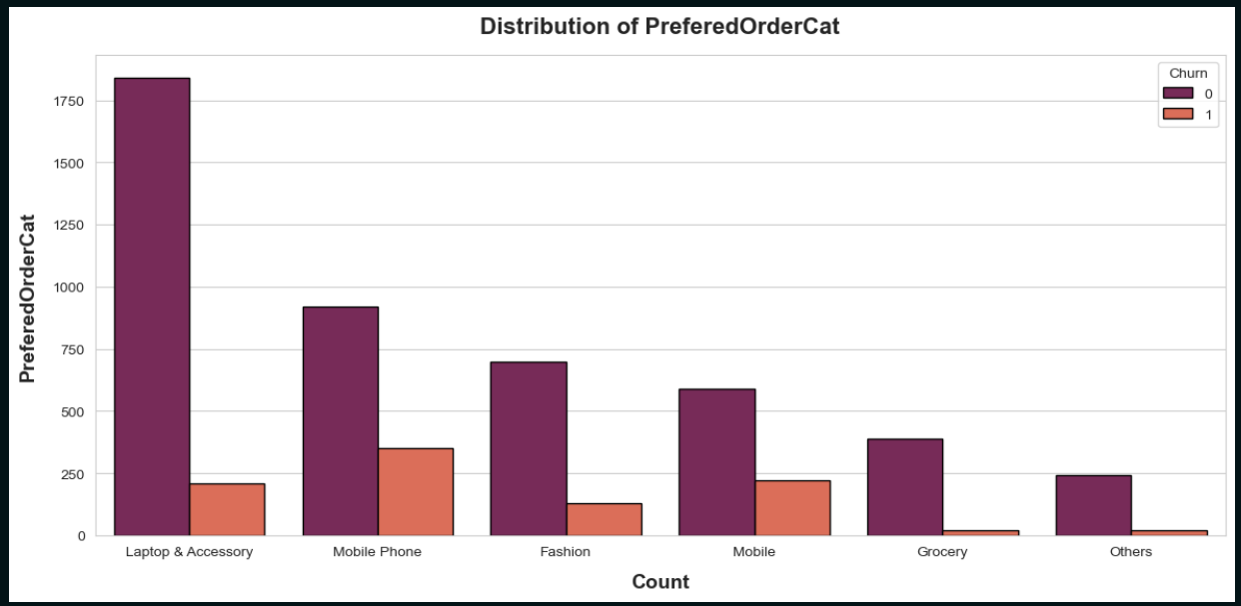
Prefered Order Category & Churn

Slide 43
Insights
Summary:
Laptop & Accessory category leads in volume with low churn.
Mobile Phone category has a higher churn rate.
1. 💻 Laptop & Accessory = Loyal Customers
The Laptop & Accessory category has the highest number of users with an extremely low churn rate.
This suggests stronger customer satisfaction or brand attachment, indicating high loyalty among these customers.
2. 📱 Mobile Phone = High Risk
Despite having a large volume of orders, the Mobile Phone category experiences high churn rates.
This suggests that Mobile Phone buyers may be more prone to leaving, requiring targeted retention strategies to maintain loyalty.
3. 📦 Smaller Categories
Smaller categories show lower churn numbers.
These segments might be ideal for upselling or bundling strategies to maximize engagement and increase order volume.
Suggestions:
Focus retention efforts on the Mobile Phone segment to reduce churn.
Leverage the loyalty of Laptop buyers for cross-sell opportunities, potentially expanding their purchases into other categories.

Slide 44
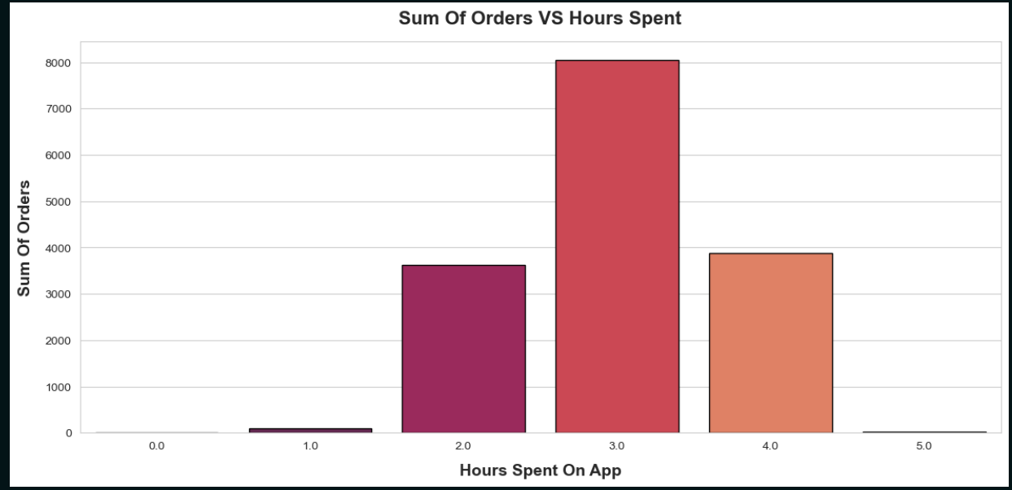
Sum Of Orders VS Hours Spent

Slide 45
Insights
The highest number of orders occurs when users spend around 3 hours/day on the app.
Very low orders are placed by users who spend either <1 hour or >4 hours on the app.
There's a drop in orders after the 3-hour peak, suggesting diminishing returns as time spent increases beyond this point.
1. Sweet Spot for Engagement:
Users spending 2–4 hours daily are the most active and likely to place more orders.
This time range represents the optimal engagement period, where users are engaged but not overwhelmed.
2. Low-Time Users (0–1 hour):
These users are likely casual visitors who may need additional encouragement to engage further.
They could benefit from onboarding, nudges, or special offers to stay longer and increase conversions.
3. High-Time, Low Orders (5+ hours):
Users spending 5 or more hours may experience decision fatigue or face challenges in the app's UX, preventing them from placing more orders.
These users may require better guidance or a streamlined interface to improve their experience and drive conversions.

Slide 46
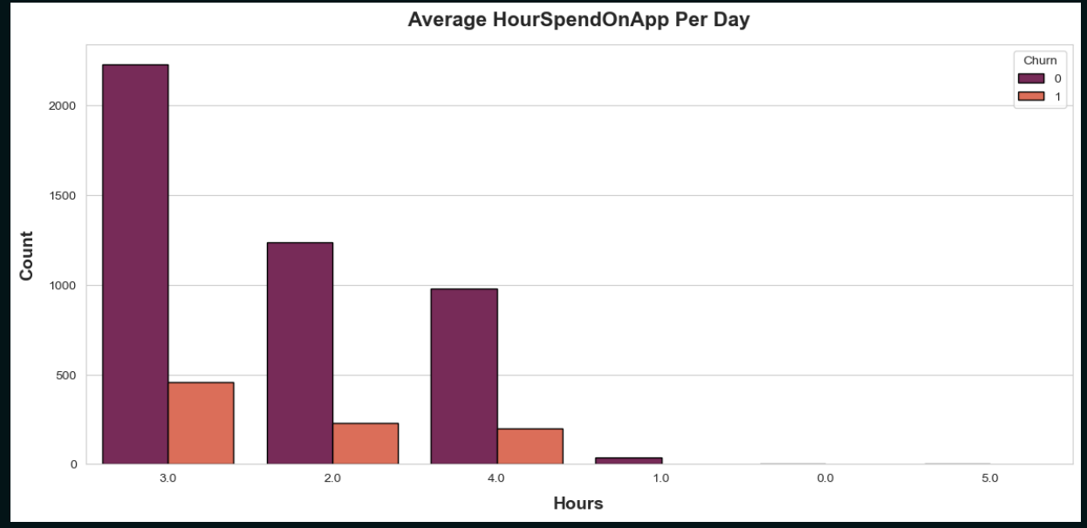
Average HourSpendOnApp Per Day & Churn

Slide 47
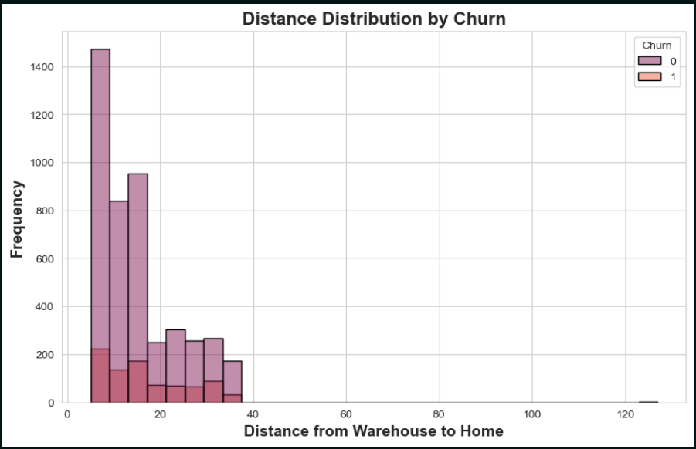
Distance Distribution & Churn
1. High Frequency at Short Distances
- Most customers live within 5–20 units from the warehouse.
- This is expected in urban setups where warehouses are closer to customer hubs.
3. Noticeable Churn at Short Distances
- Even with better proximity, churn still occurs significantly at short distances.
4. Lower Churn Counts at Long Distances
- Fewer customers live far from the warehouse.
- Churn appears lower, likely due to low sample size, not necessarily satisfaction.

Slide 48
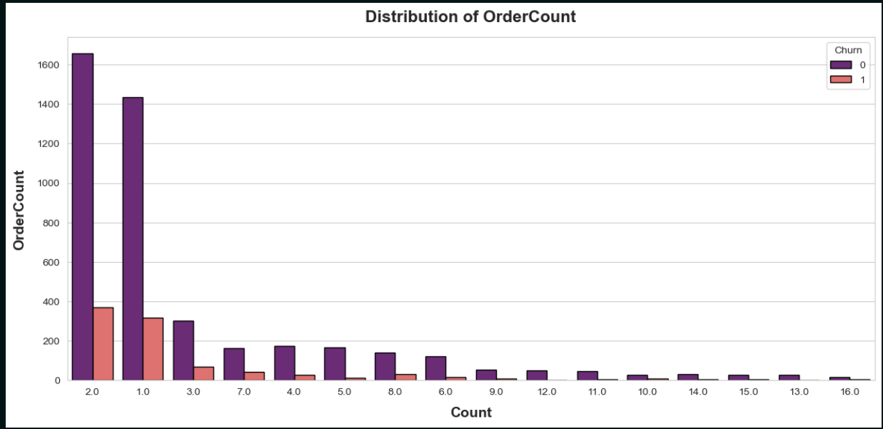
OrderCount & Churn

Slide 49
Insights
Most Users Place Only 1–2 Orders
Insight: The majority of users have 1 or 2 total orders.
Implication: Many customers are likely new or infrequent users.
High Churn Among Low Order Counts
Insight: A significant portion of churners belong to the 1–2 orders group.
Implication: Many users may try the app once or twice, then never return.
Possible One-Time Use Behavior
Insight: Users with 1–2 orders may:
Have achieved their goal with a single purchase (e.g., a specific promotion).
Encountered a bad experience early on.
No longer have need for the service.

Slide 50
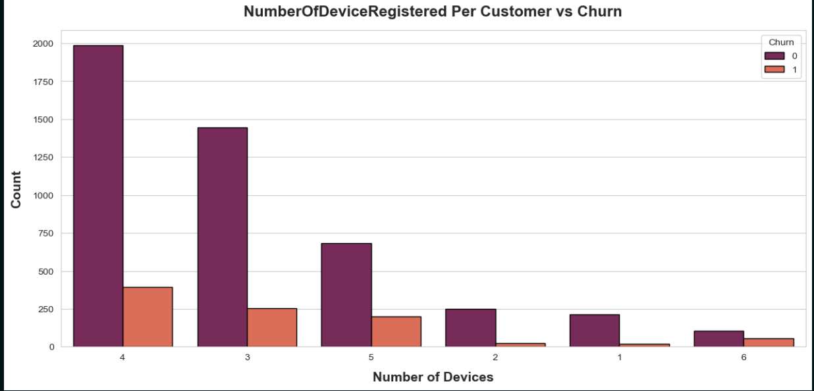
Number Of Device Registered & Churn

Slide 51
Insights
Higher Device Count = Lower Churn
Insight: Users with 3–5 registered devices show lower churn rates.
Implication: Stronger user engagement, possibly due to households with multiple users or individuals accessing the app on different devices (e.g., phone, tablet, smart TV).
Lower Device Count = Higher Churn Tendency
Insight: Users with only 1–2 devices tend to have a higher churn percentage.
Implication: These users may be less engaged, possibly testing the app or using it only occasionally.
Device Count Reflects App Preference
Insight: A higher number of registered devices likely signals that the user:
Likes the app, feels comfortable, and possibly considers it their preferred platform.
Engages with the app in various contexts (e.g., home, work, on the go).

Slide 52
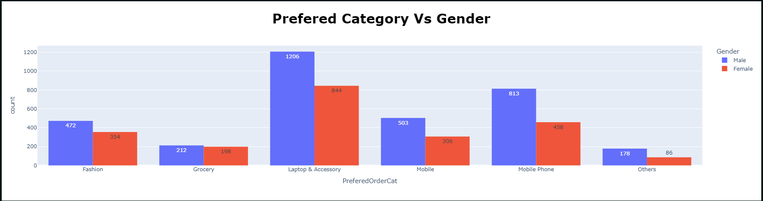
Prefered Order Category & Gender

Slide 53
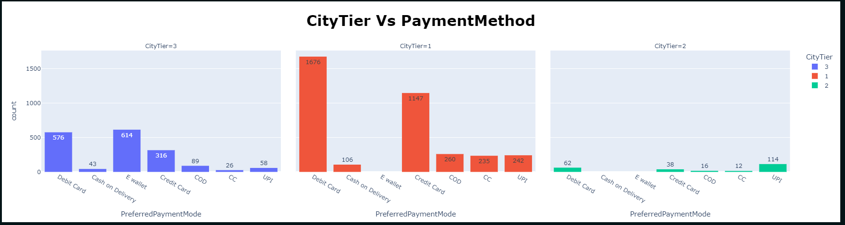
Preferred Payment Mode & City Tier

Slide 54
Insights
CityTier 1 (Urban - Red)
Highest User Count
Top Payment Modes:
Debit Card: 1676
Credit Card: 1147
Other modes used: UPI (242), COD (260), CC (235)
Insight: Bank-based digital payments are the most preferred in urban areas.
CityTier 2 (Semi-Urban - Green)
Lowest User Count
Top Payment Mode:
UPI: 114
Other modes have minimal usage.
Insight: Low engagement overall, with some adoption of UPI.
CityTier 3 (Rural - Blue)
Moderate User Count
Top Payment Modes:
E-Wallet: 614
Debit Card: 576
Notable also: Credit Card (316)
Insight: Wallets and debit cards are favored in rural areas.

Slide 55
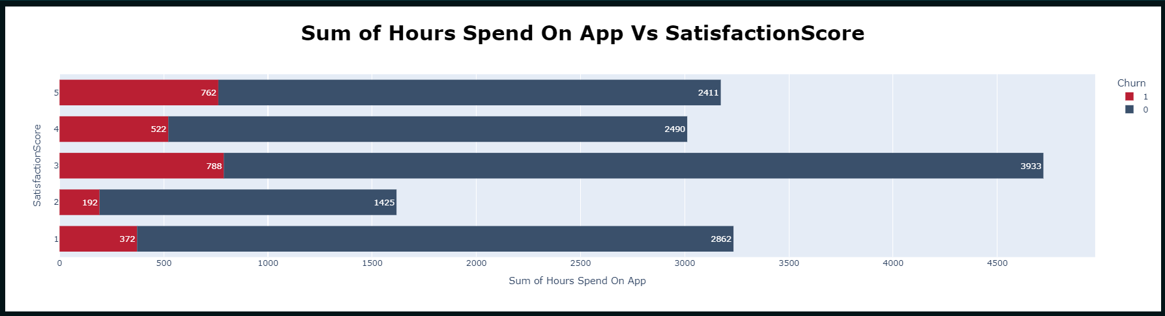
Sum of Hours Spend On App & Satisfaction Score

Slide 56
Insights
Score = 3 → Most Valuable
Highest total usage: ~3933 hours (non-churned)
Insight: Users are highly engaged and loyal, indicating strong satisfaction and commitment.
Score = 1 → High Usage, High Risk
Usage: ~2862 hours spent despite low satisfaction
Churned: 372 users
Insight: These users are active but frustrated, suggesting a need for improvement in their experience to prevent churn.
Churn Across All Scores
Even users with high satisfaction (Score 5) churn: 762 churned
Insight: Churn is influenced by more than just satisfaction; factors beyond satisfaction may contribute to the decision to leave.
Score = 2 → Low Usage
Lowest total hours: ~1617
Insight: These users are disengaged but still partially churn, indicating a lack of meaningful interaction with the platform.

Slide 57
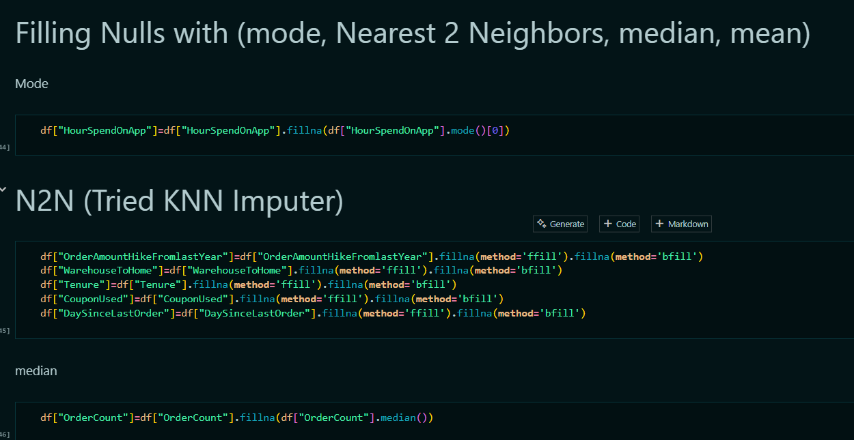
Handling Nulls With Different Techniques

Slide 58
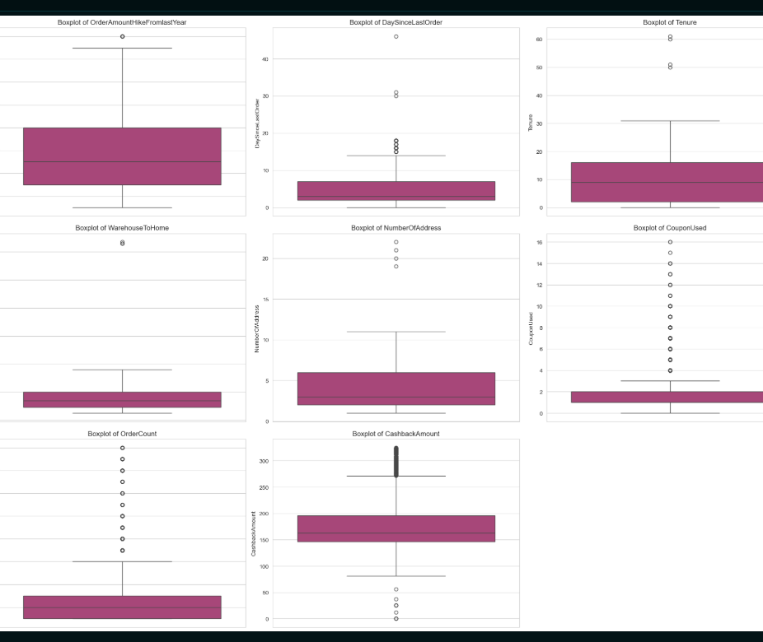
Handling Outliers

Slide 59
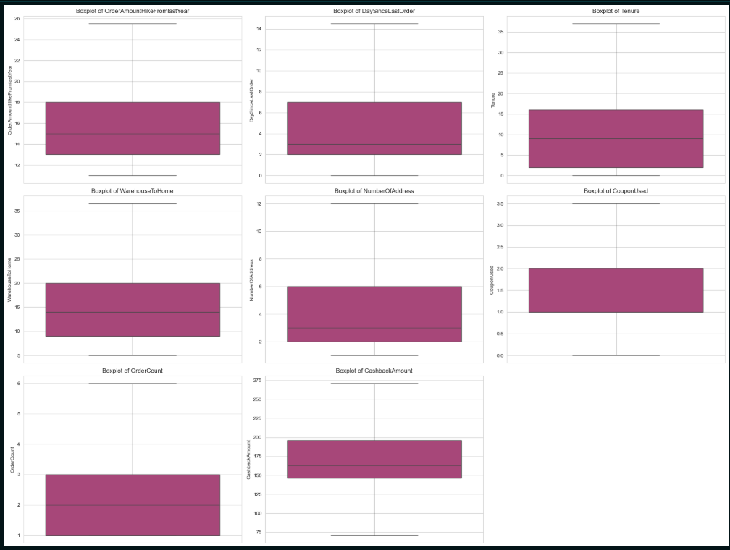
After Applying IQR With its Boundries

Slide 60

Feature Engineering

Slide 61
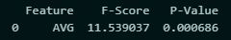
1- Average orders for each Customer Per Hour
This New Column for Average Orders made last month for each customer divided by hour spend on app
Then measured the correlation:
By anova for Numerical & Categorical

Slide 62
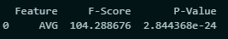
2-Average CashBack Based on Order count and grouped by each category
Column for Average cashback amount for each order category
Then measured correlation with annova too
And it was a high value correlated with the target

Slide 63
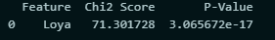
3- divide Tenure based on The years Spent
Make New Column (Loyalty Score) depends on the Tenure Column
Then measured correlation with annova
And it was a high value correlated with the target

Slide 64
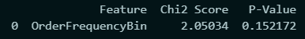
4- frequency of Orders Categorized
This column for classifying the customers according to there number of orders
Then measured correlation with annova
And it wasn’t highly correlated this will be measured later with other columns

Slide 65
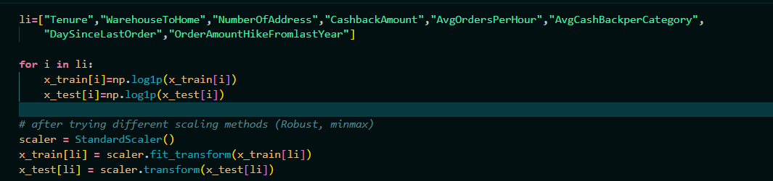
Scaling
This part of the code after splitting the data first we made log transform to make the data more symmetric
Then tried different scaling methods and the best was standard

Slide 66
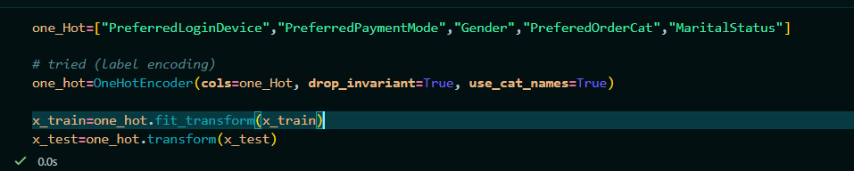
Encoding
Here we tried some encoding methods and measured the accuracy of models and the best one was one hot encoding

Slide 67

Measuring Correlation

Slide 68
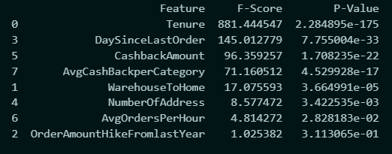
Numerical Columns
Annova for Categorical (Target) & Numerical

Slide 69
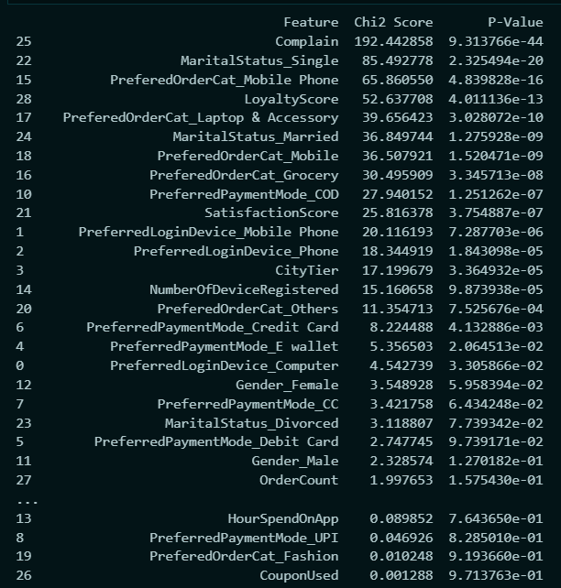
Categorical
Chi_2 Score for Categorical & Categorical

Slide 70
Dropping Irrelevant Columns to the Target
After measuring the correlation between all features and the target variable,
we initially dropped the columns with low correlation.
when we evaluated the model's accuracy, we found that the performance was better when those features were retained.
This suggests that even low-correlation features can contribute valuable information to the model, especially when combined with other features.

Slide 71
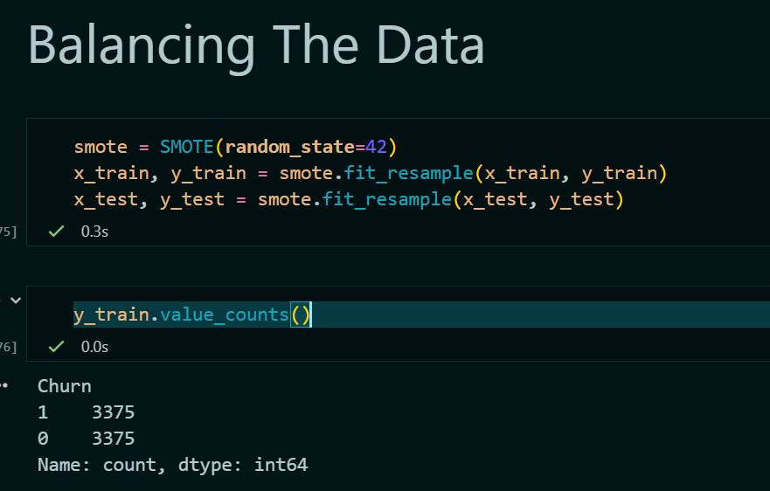
Balancing The Data
The dataset was imbalanced, so we experimented with balancing techniques such as oversampling and undersampling.
due to the small size of the dataset and the impact on model accuracy, we decided to proceed with oversampling, as it yielded better results.

Slide 72
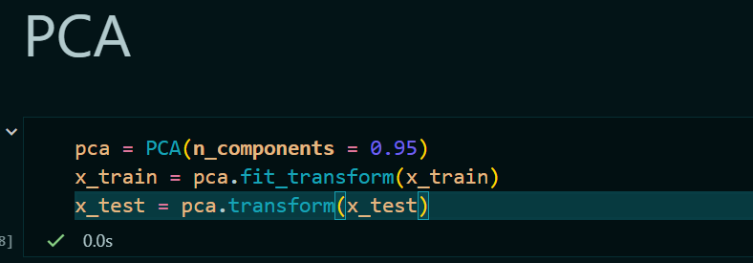
PCA
Before training the models, we applied PCA for dimensionality reduction to evaluate its impact on performance.
the accuracy decreased across all the models we tested.
Ultimately, the best-performing model achieved higher accuracy without PCA, so we chose not to apply dimensionality reduction in the final approach.

Slide 73
Model Training

Slide 74
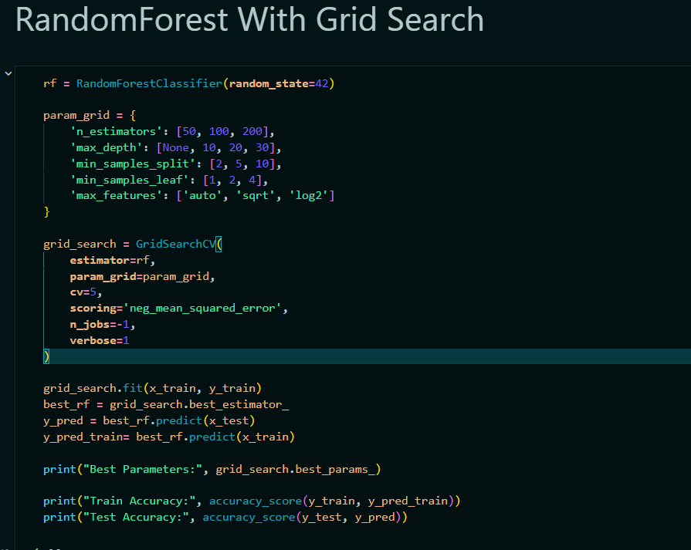
1- RandomForest With Grid Search

Slide 75
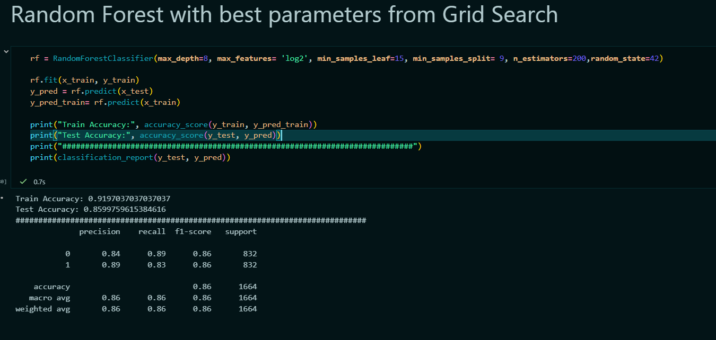
Random Forest With Best Parameters & Evaluation

Slide 76
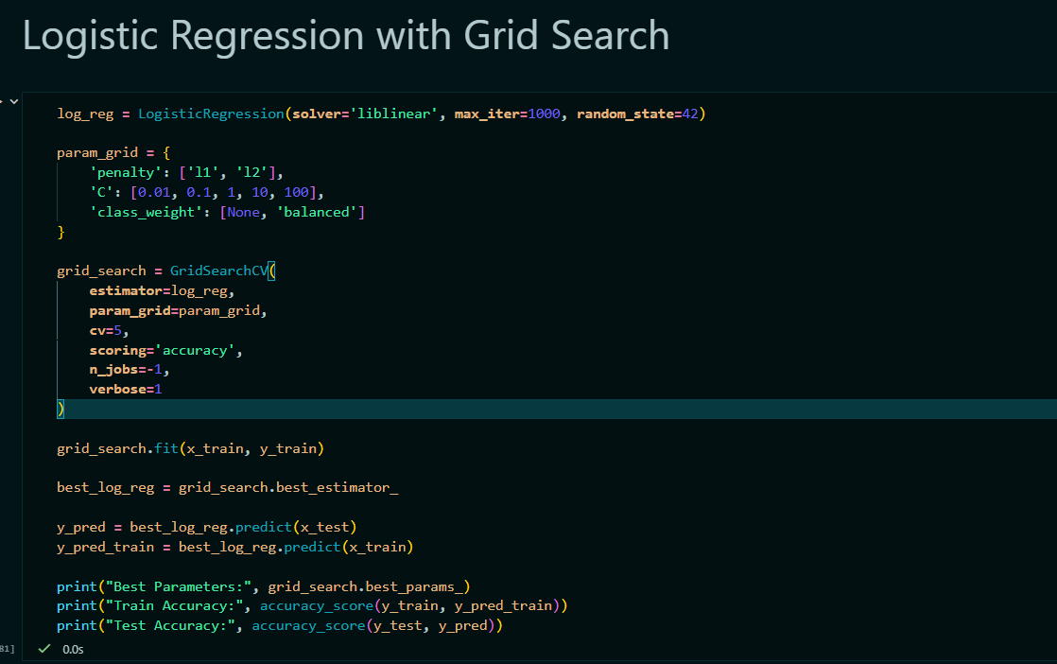
2- Logisitc Regression

Slide 77

Logistic Reg With Best Parameters

Slide 78

3- SVM

Slide 79

SVM With Best Parameters

Slide 80

ROC-AUC

Slide 81

Confusion Matrix

Slide 82

PCA Scatter Plot

Slide 83

XGBOOST With Best Parameters

Slide 84

CATBOOST With Best Parameters

Slide 85

Best Model
After experimenting with various models using different encoding techniques, scaling methods, with and without PCA,
and by dropping or retaining low-correlation features,
we found that the best-performing model was Support Vector Machine (SVM).
Here are the accuracy score and classification report for the SVM model.

Slide 86

Saving Best Model For Deployment

Slide 87

Deployment

Slide 88

1- Handling New Features

Slide 89

2- Log Transform & Scaling

Slide 90

3- Encoding & Order Features

Slide 91

User Interface of the Developed Web App

Slide 92

For Prediction

Slide 93

Future Work
To further enhance the project, future development will focus on:
Building a mobile version of the application for broader accessibility.
Performing advanced feature engineering by creating new, insightful columns to improve model performance.
Exploring different datasets to uncover hidden trends and enhance the generalizability of the models.
Developing more interactive visualizations to better support stakeholders in understanding and acting on the insights provided.

Slide 94
Conclusion
In this project, we conducted a comprehensive analysis of E-Commerce data, applied machine learning models to generate meaningful predictions, and successfully deployed the solution through an interactive web application using Streamlit. The project not only provided insights into customer behavior and purchasing patterns but also demonstrated the effectiveness of data-driven decision-making in the eCommerce domain.

Slide 95
Directed by
1- Mohamed Tarek Eleraky
2- Abdulrahman Ghareeb Abdulsattar
3- Ahmed Mohamed Ahmed
4- Omar Ahmed Abdelaziz
5- Mohamed Ahmed Aziz

Slide 96


